Slide 1

What’s Cooking….
One cannot think well, love well, sleep well, if one has not dined well

Slide 2

Team Members.
Frontend
Backend
Vineet Padmakar Mulik
Saket Singh Bhadauriya
Damini Rajesh Gujar
Chinmayee Senapati
Kadunuri Vamshi
S Padma iswariya
Snehal Kumar Khot
Rayapalli Vijay
Chintha Kavitha
Davala Likitha

Slide 3

Introduction.
A recipe is a set of instructions that describes how to prepare or make something.​
A recipe is to have a precise record of the ingredients used, how much amount of ingredients are needed and the way they are combined.

Slide 4
Abstract.
The main objective of this web application is to create a dynamic and responsive Java application to allow a user to the application and search for recipes online.
This application helps genuine food lovers to explore and have wonderful experience with the recipes uploaded.

Slide 5
Modules.
Admin
User

Slide 6



Technology Used :
Frontend: Angular
Backend: MySQL, Hibernate
Server side: Spring Boot
Server: Apache Tomcat
Testing: POSTMAN, JUNIT

Slide 7

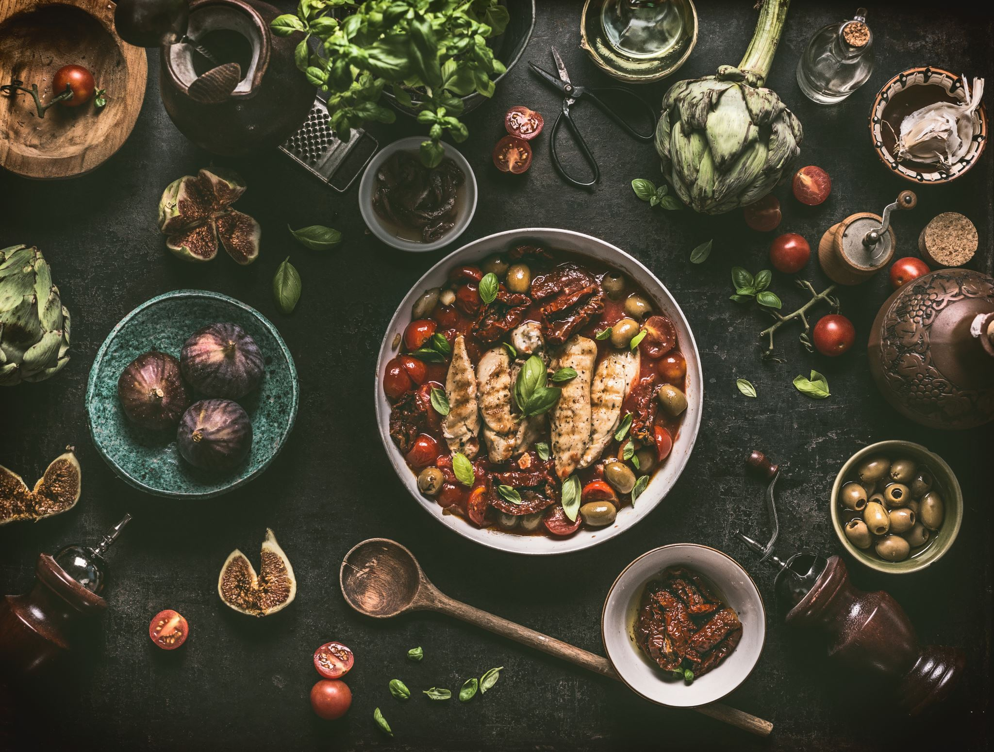
Admin:
Admin will be able to :
Login to the portal
Admin can add / remove or even endorse a recipe
Edit recipe details like name, item details, ingredients and cooking steps

Slide 8
Admin Flow:
View all recipes
Login
Edit recipe
Admin
Add recipes
Remove recipe
Logout

Slide 9

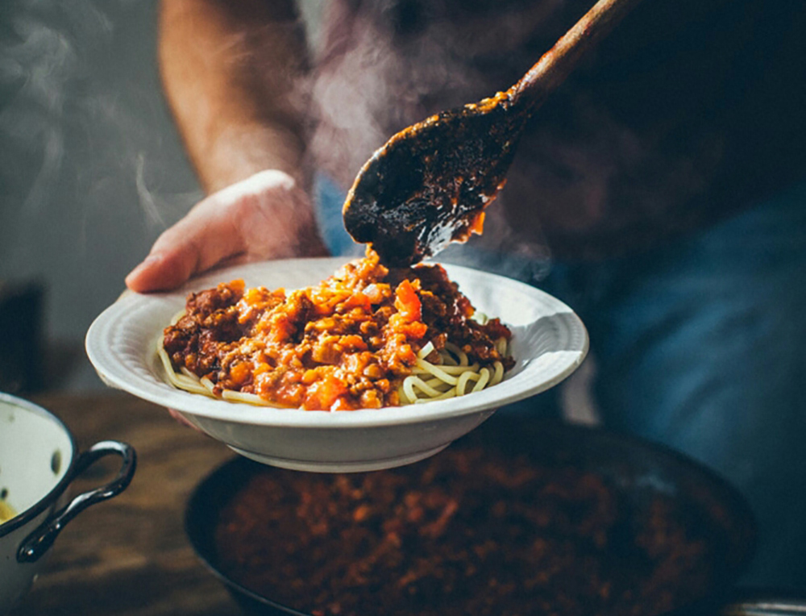
User:
User will be able to :
Register to the application
Sign in to the application
Search for recipes based on the search keyword
Can see selected recipe details
Can also like and comment on the item recipe

Slide 10
User Flow:
User
Search keyword
Login
View all recipe
Search recipe
Register
Like
If New User
Logout

Slide 11
Description:
REGISTER * A user needs to register in order to access the application. * The user needs to enter his/her username, password, phone number . Those information will be stored in the database and will serve as the profile info. LOGIN * Any application operation requires the user to be registered. * Login is the first step before performing an action.
EDIT * The admin will be able to add/remove or endorse the recipe based on his requirement * He will also be able to edit the name, item details and keep it always updated

Slide 12
VIEW INGREDIENTS * The admin and registered user of the application shall be able to view ingredients of a certain recipe. VIEW RECIPES * The admin and registered user shall be able to see all the recipes that is present in the application.
SEACH RECIPES *Any registered user shall able to search for a recipe using the
search bar provided. * The search functionality will provide the users with a shortcut to find their targeted recipes.

Slide 13
User Case Diagram Admin:
Login
Add/Delete recipes
Admin
Edit recipe
Database
Refresh
Logout

Slide 14
Use Case Diagram User:
Register
View all recipe
User
Database
Search recipe
View selected recipe
Like

Slide 15
OUTPUT

Slide 16
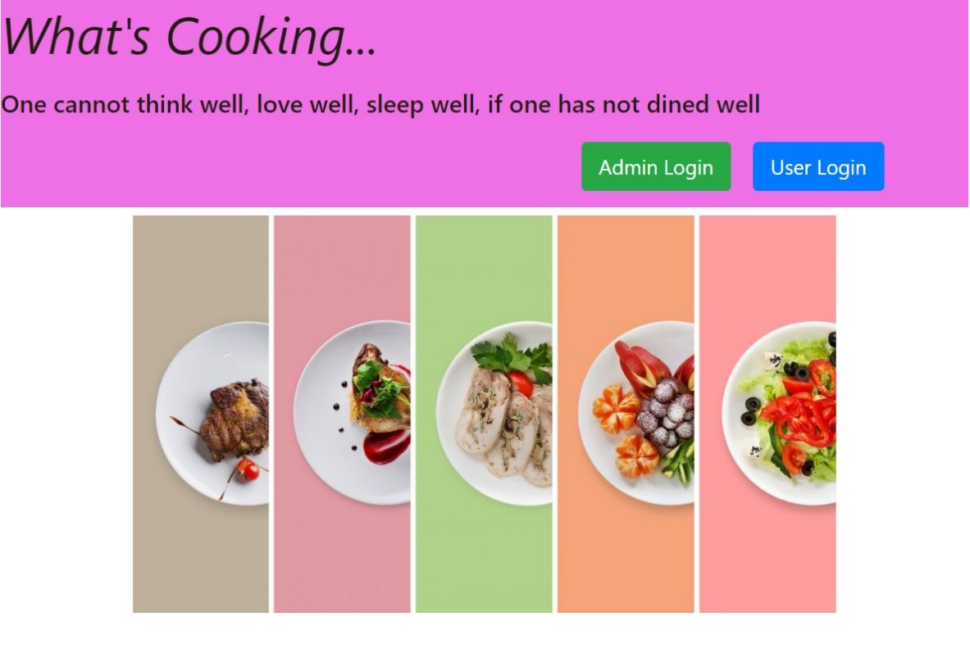

Slide 17
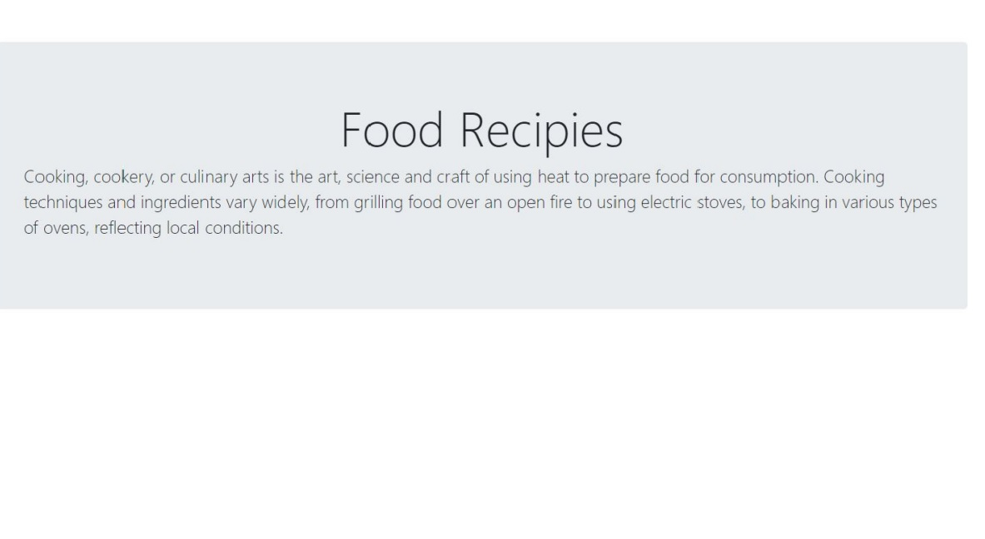

Slide 18
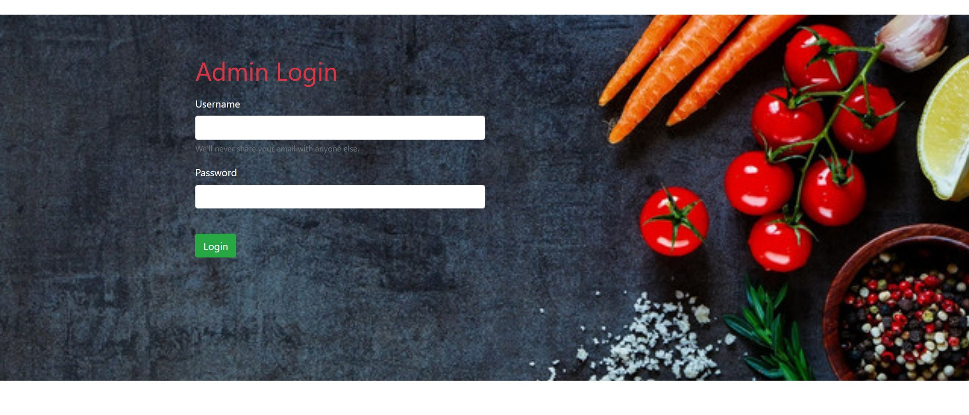

Slide 19
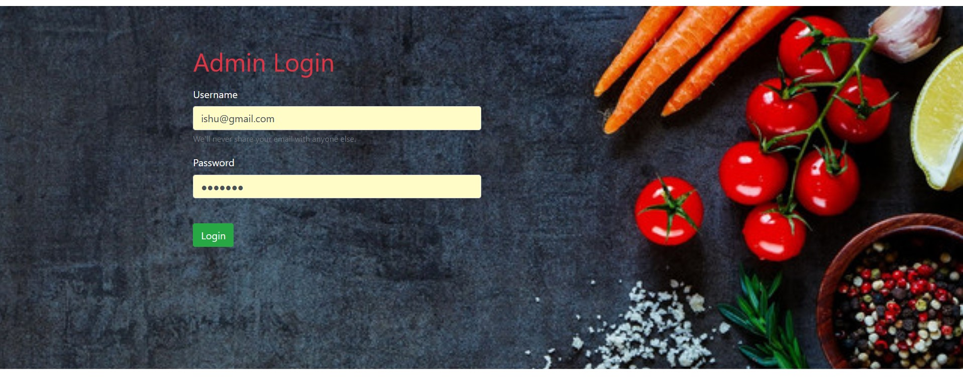

Slide 20
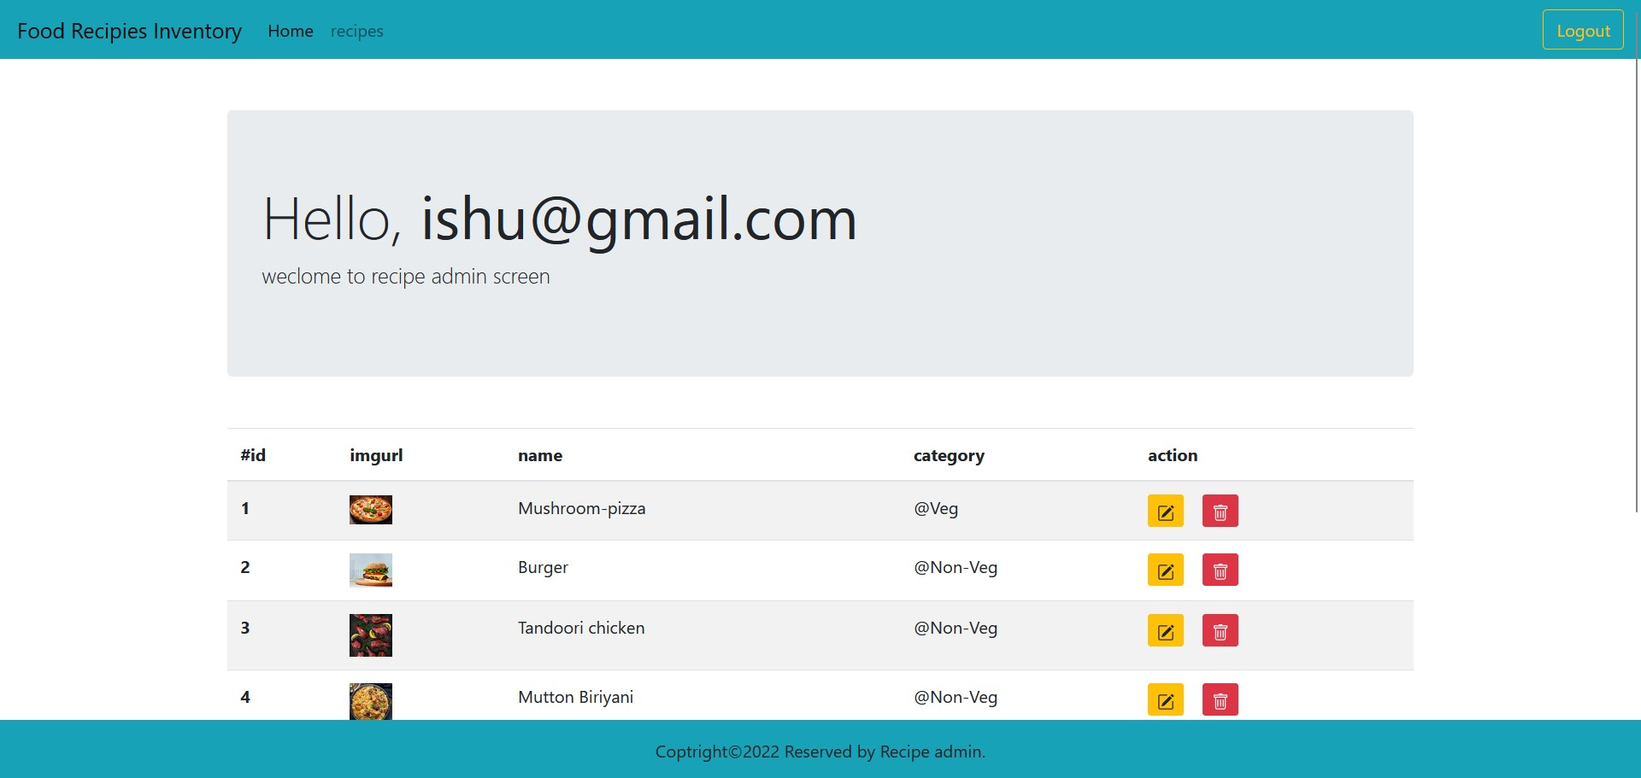

Slide 21
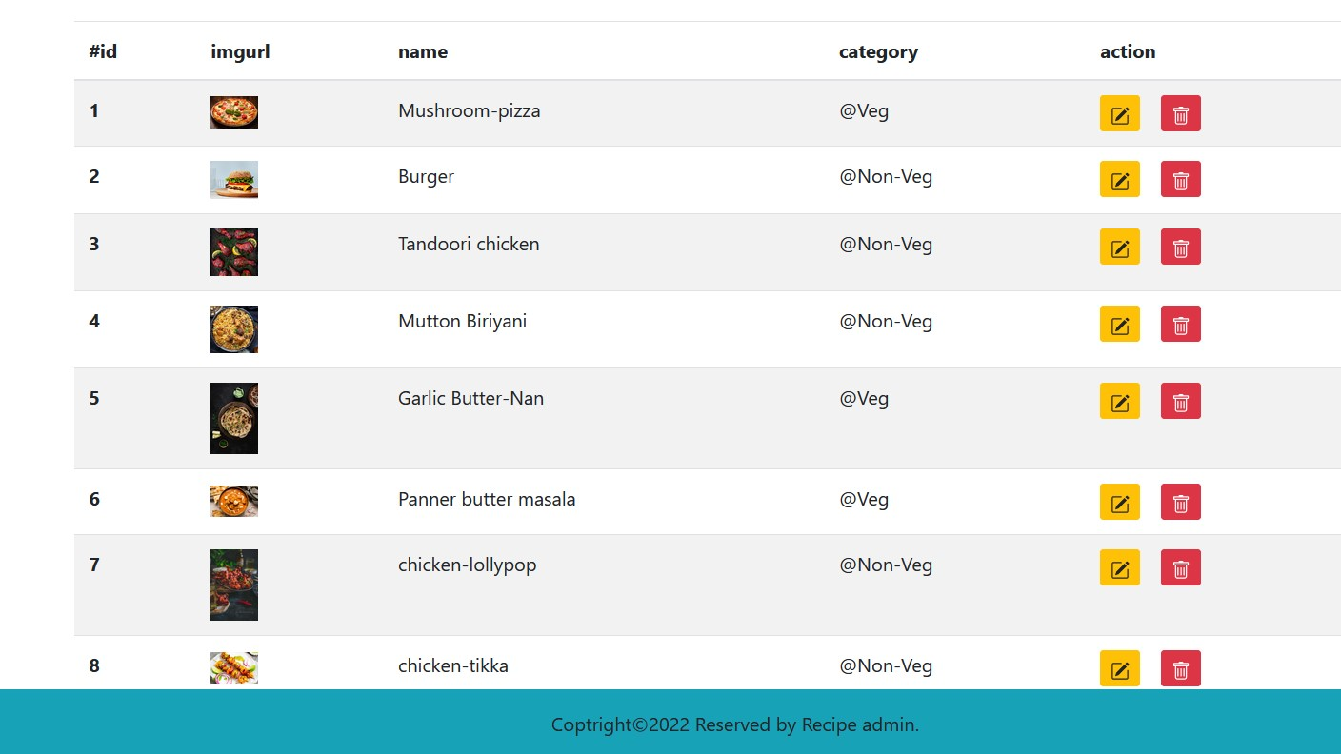

Slide 22
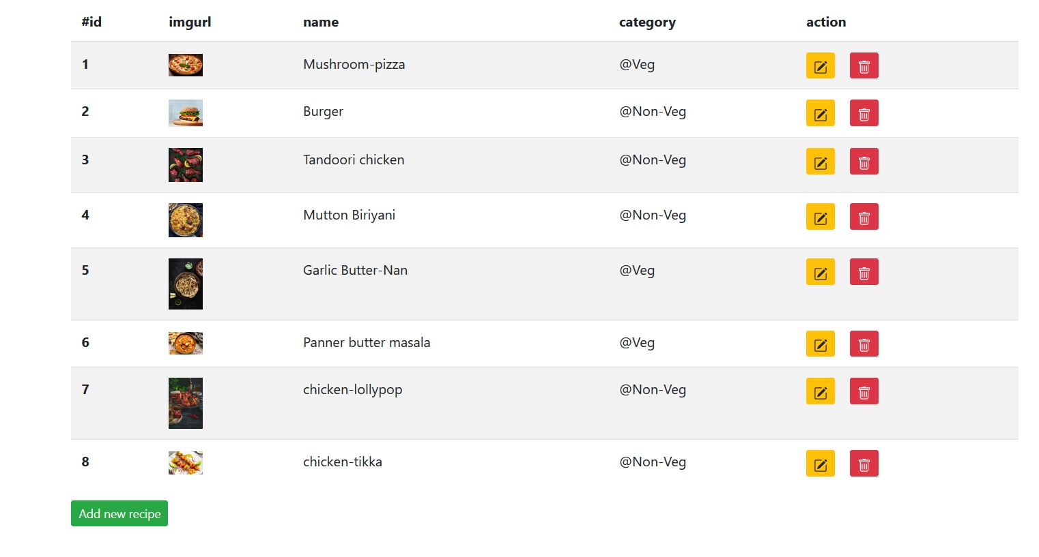

Slide 23
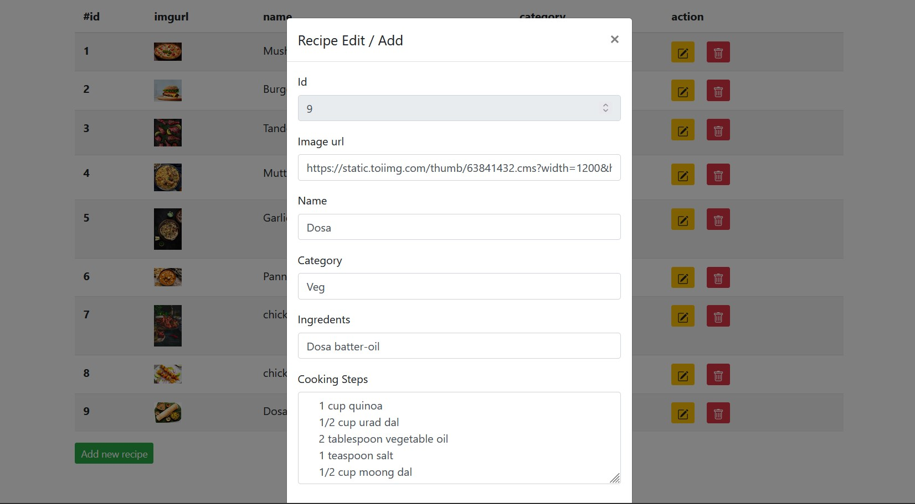

Slide 24
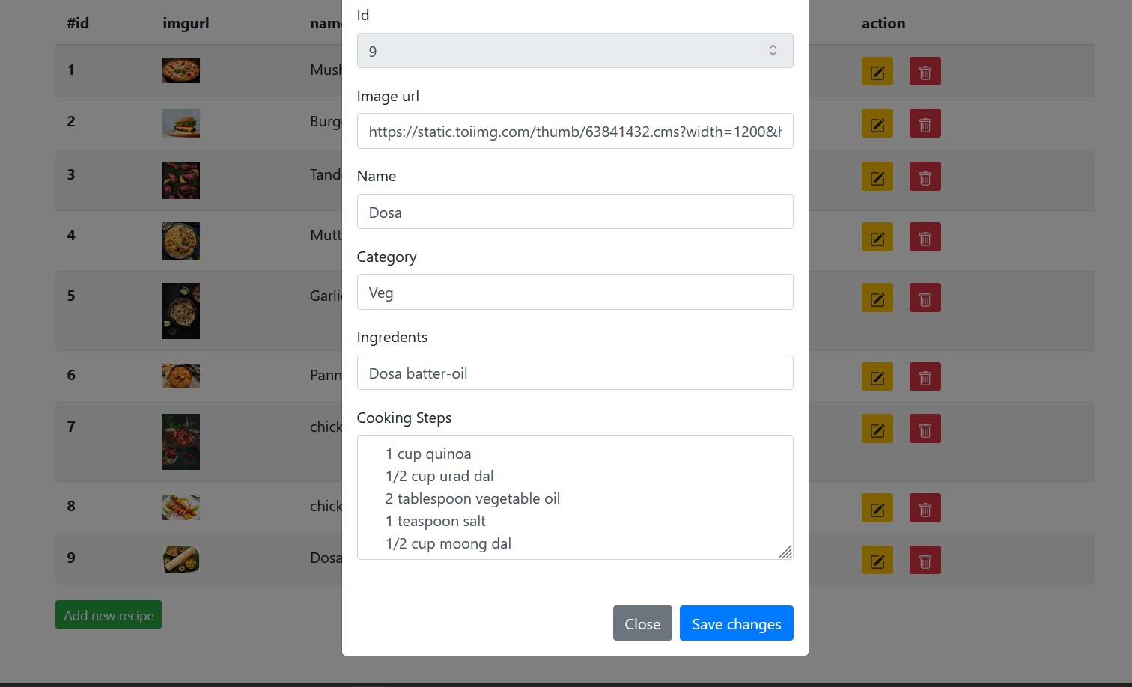

Slide 25
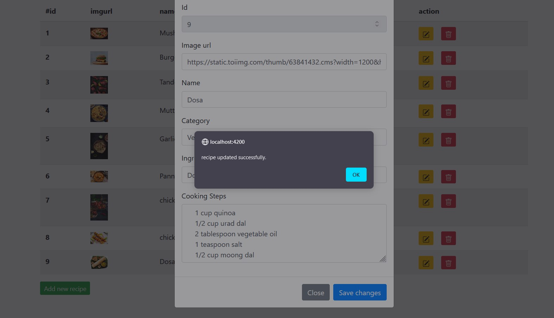

Slide 26
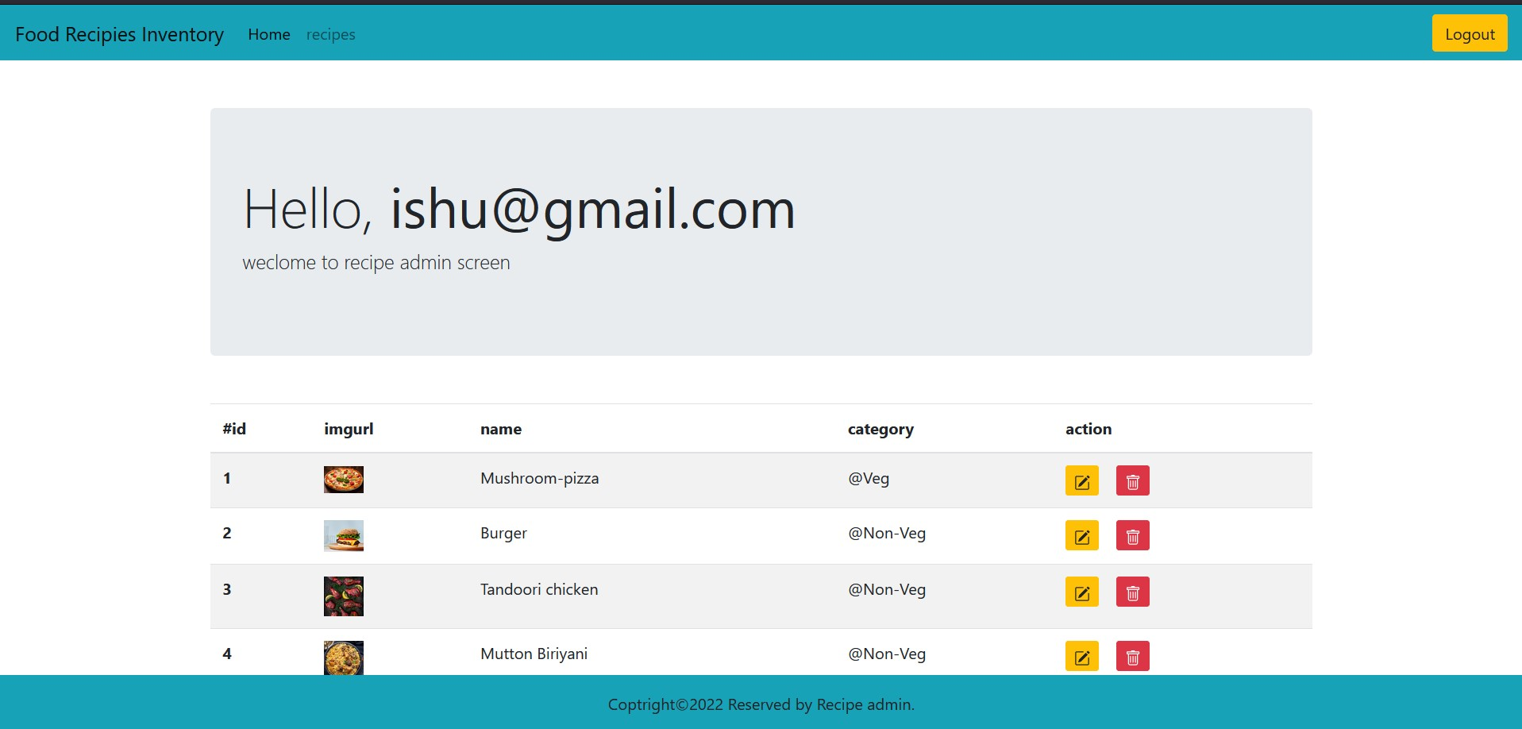

Slide 27
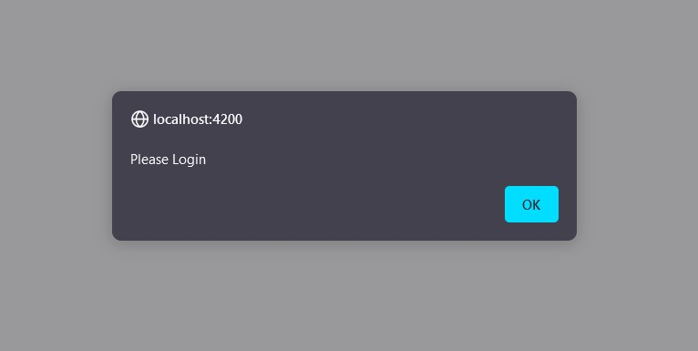

Slide 28
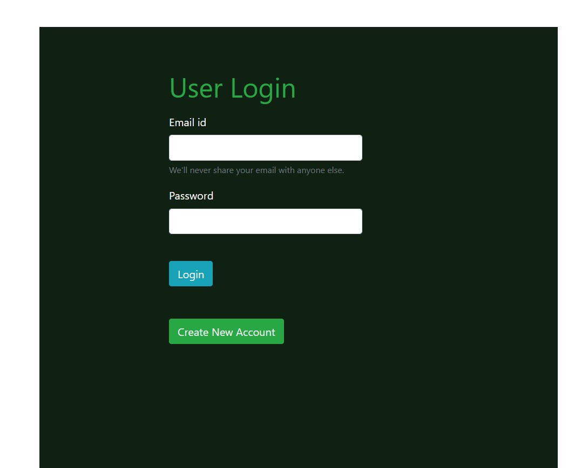

Slide 29
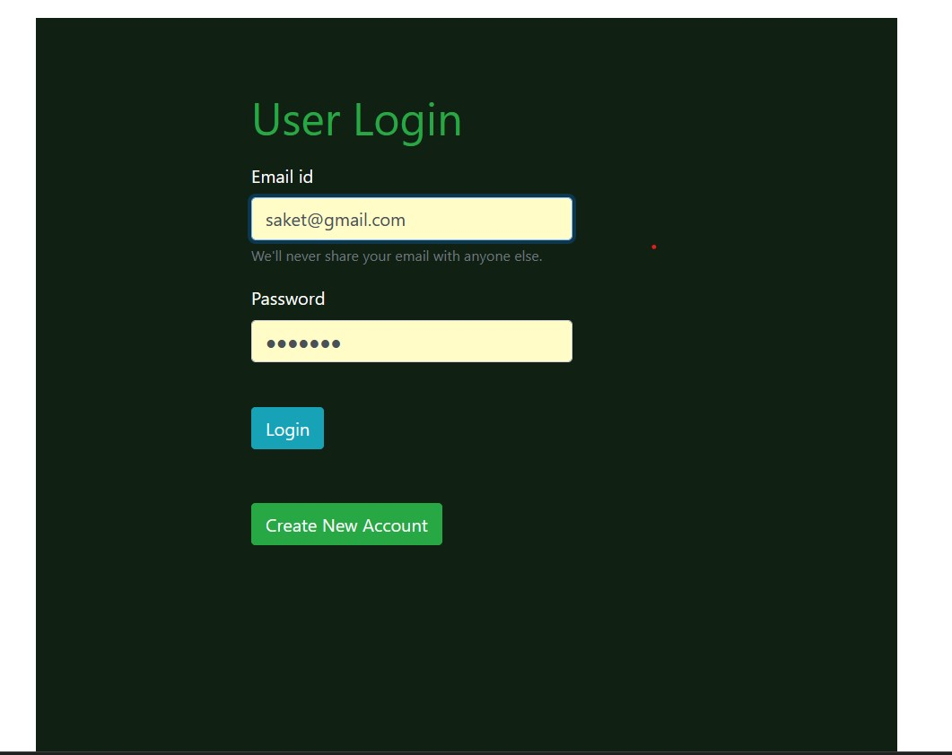

Slide 30
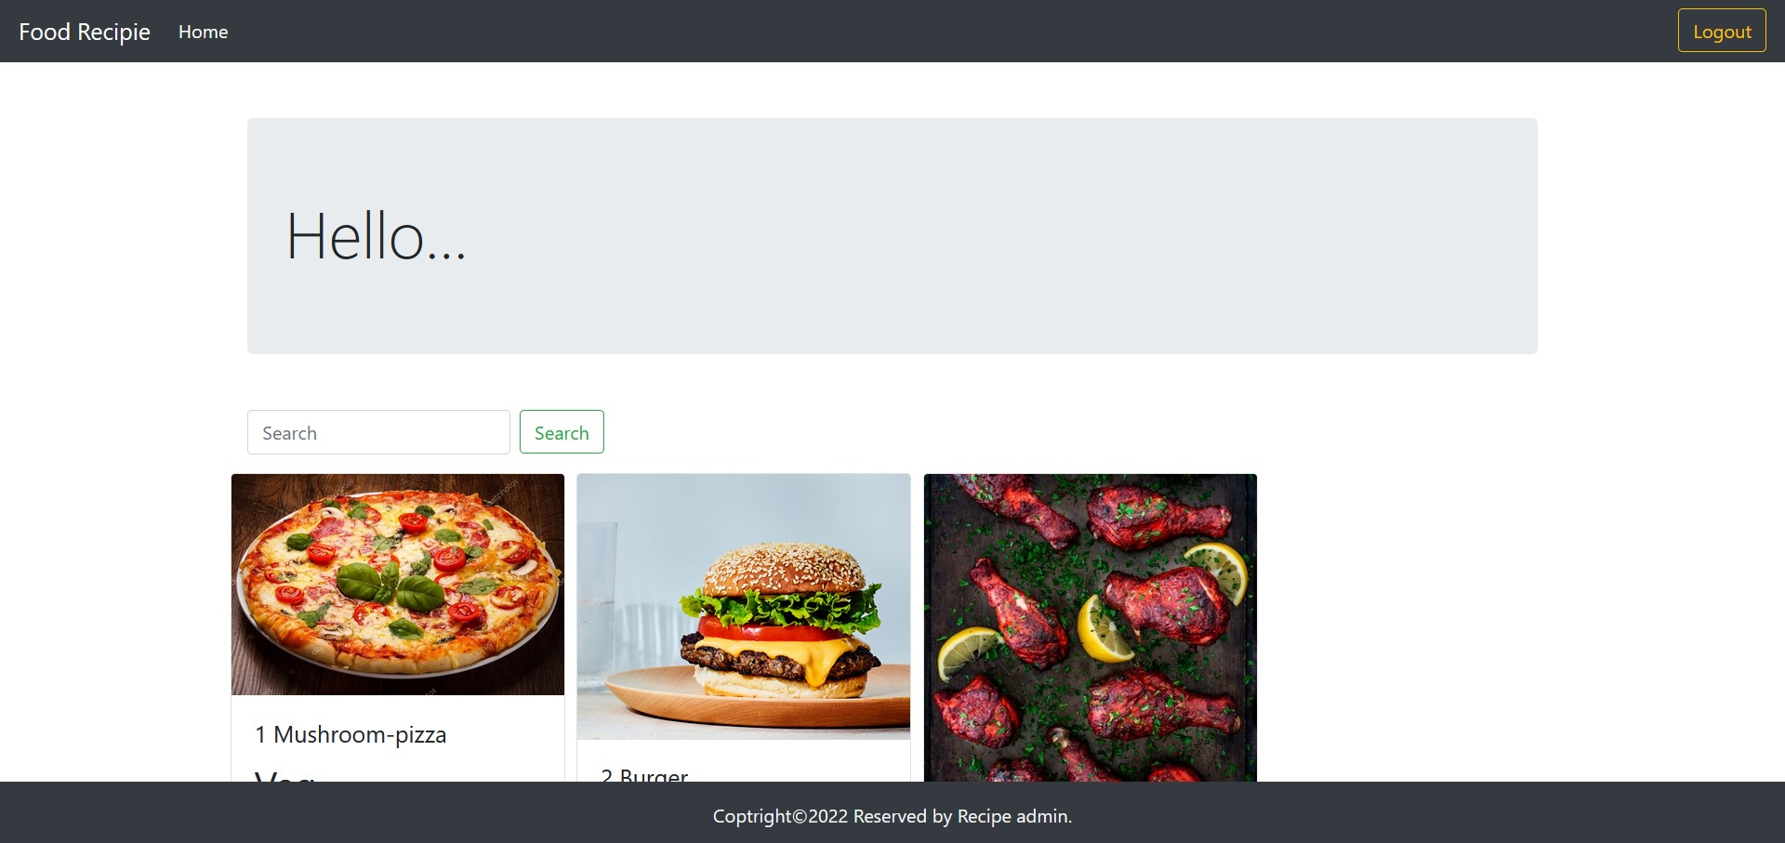

Slide 31
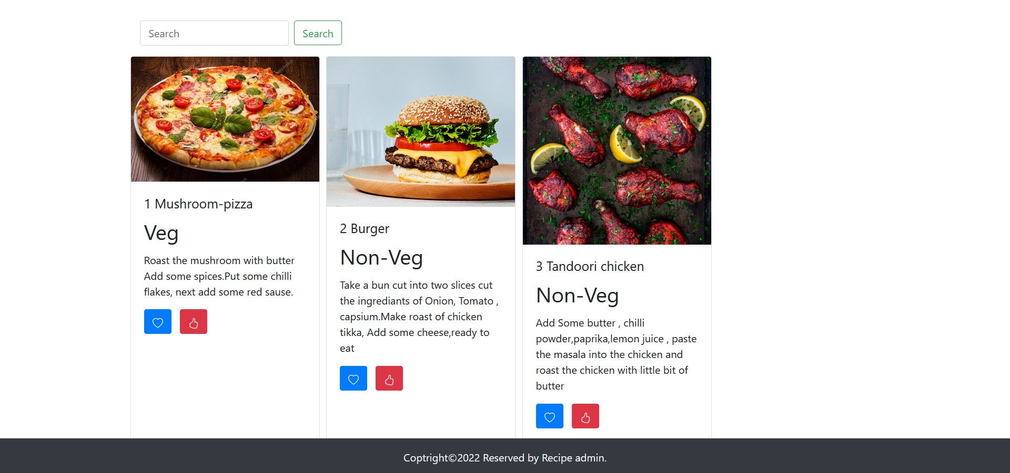

Slide 32
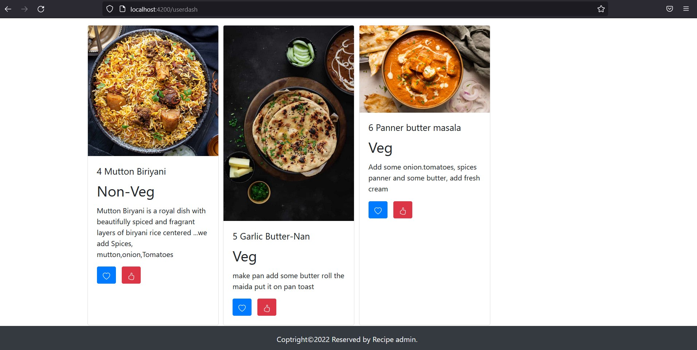

Slide 33
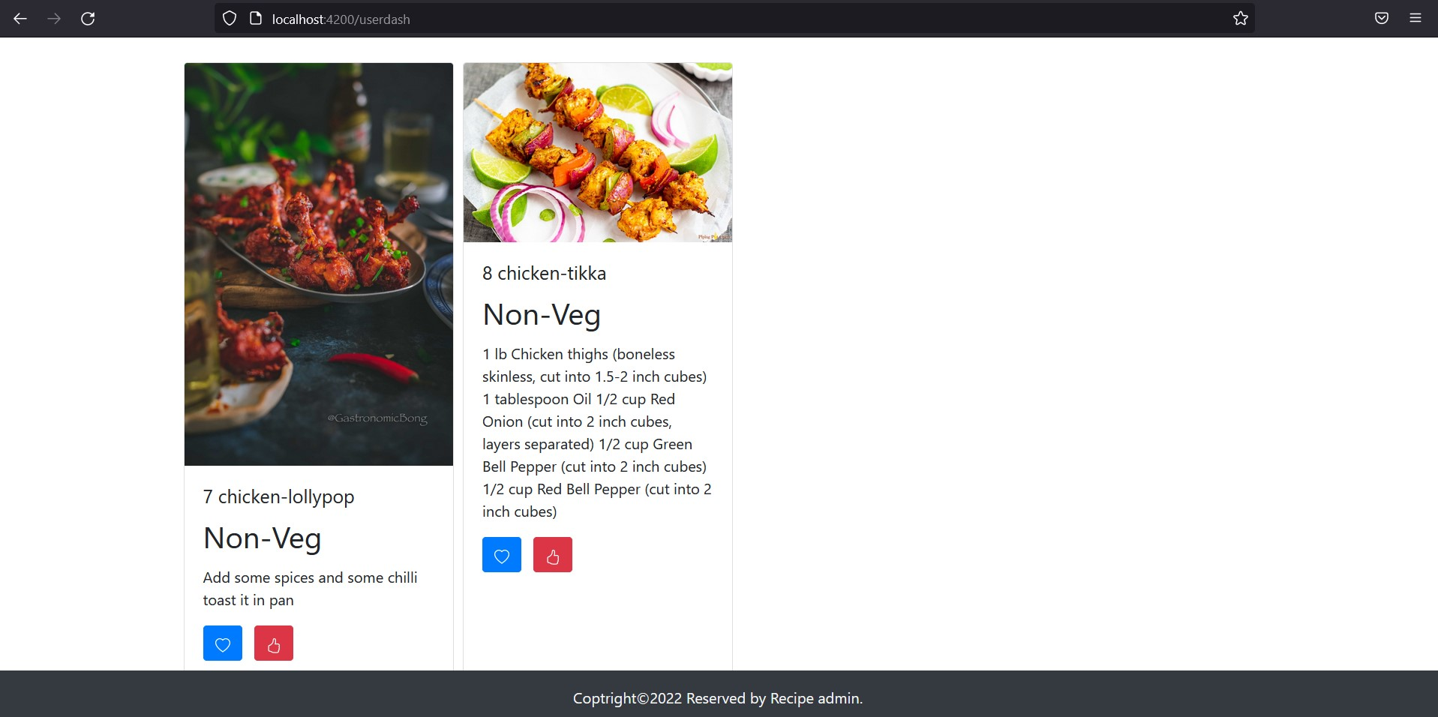

Slide 34
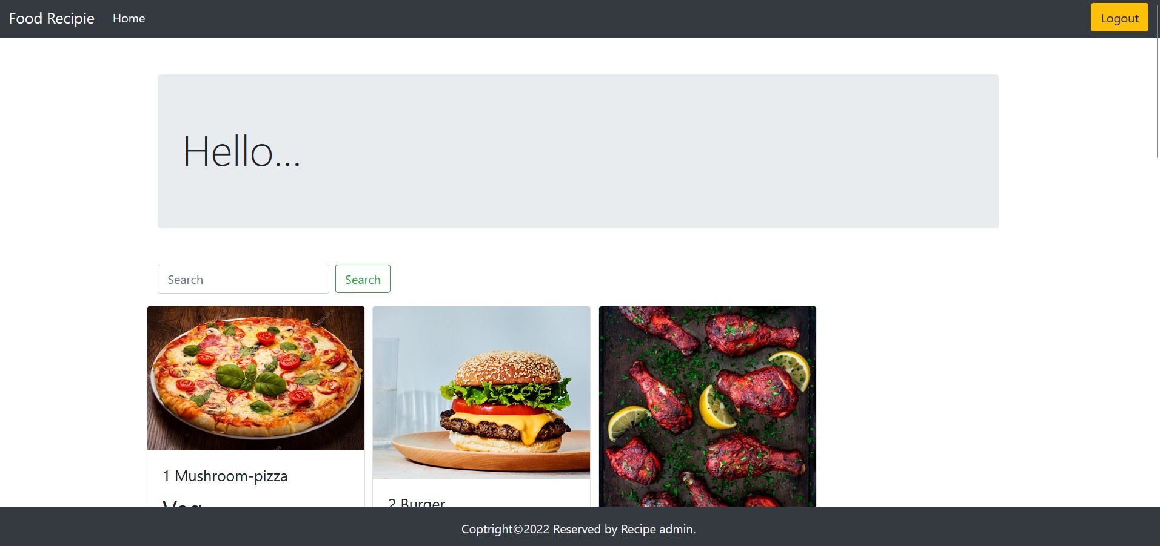

Slide 36
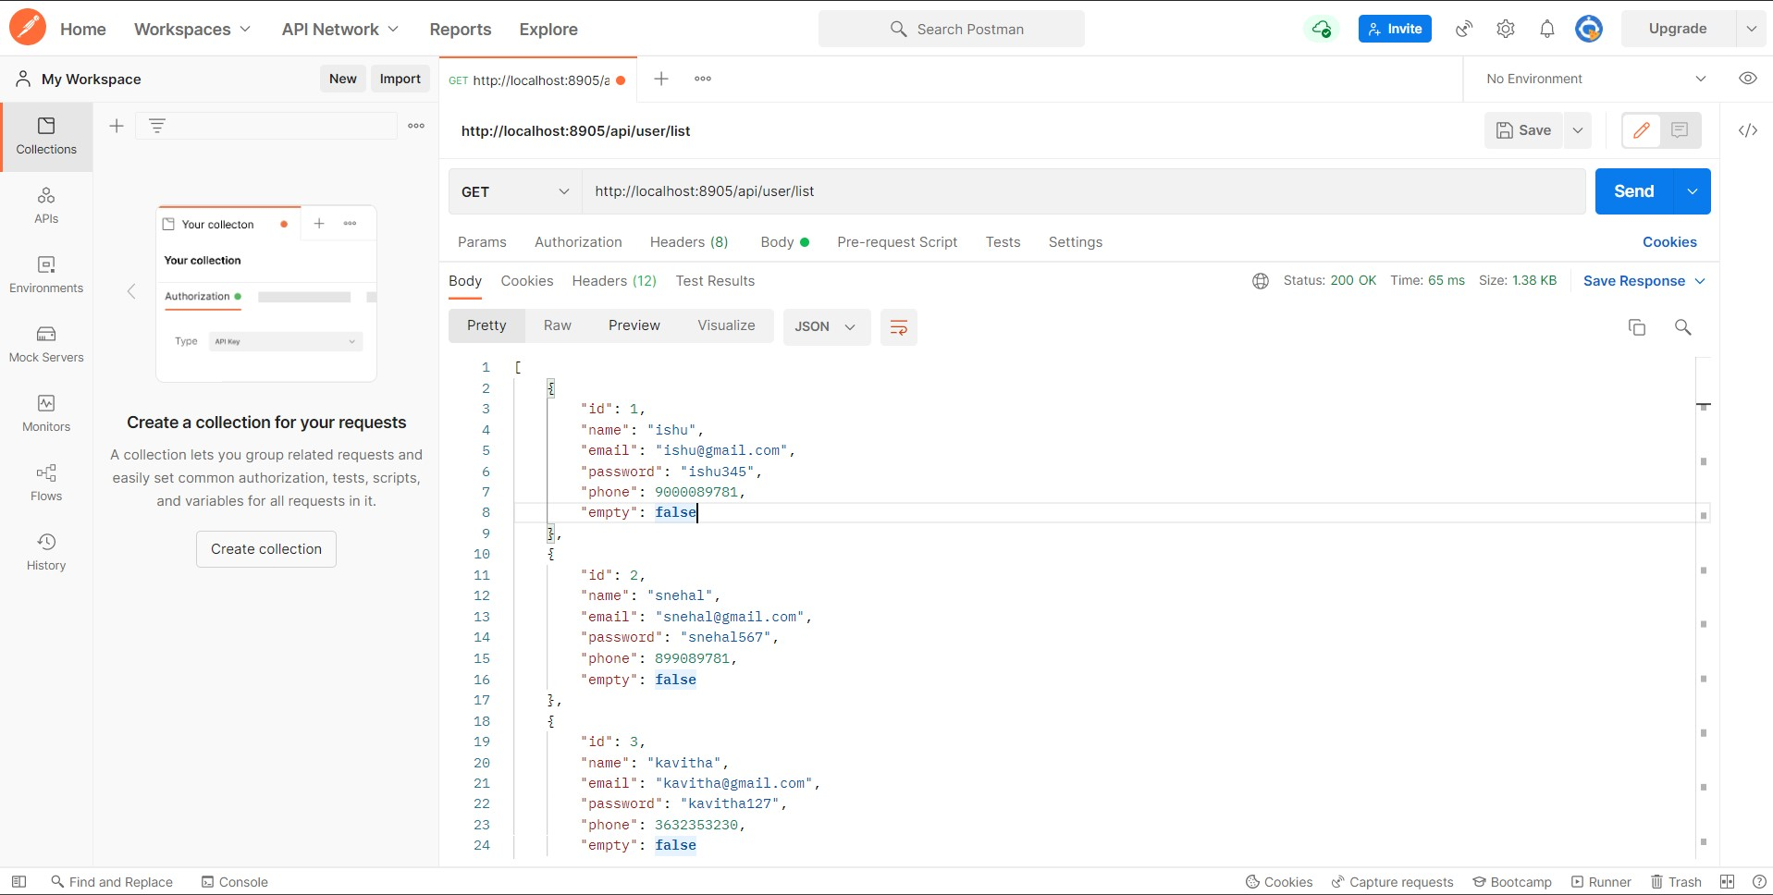
POSTMAN Testing

Slide 37
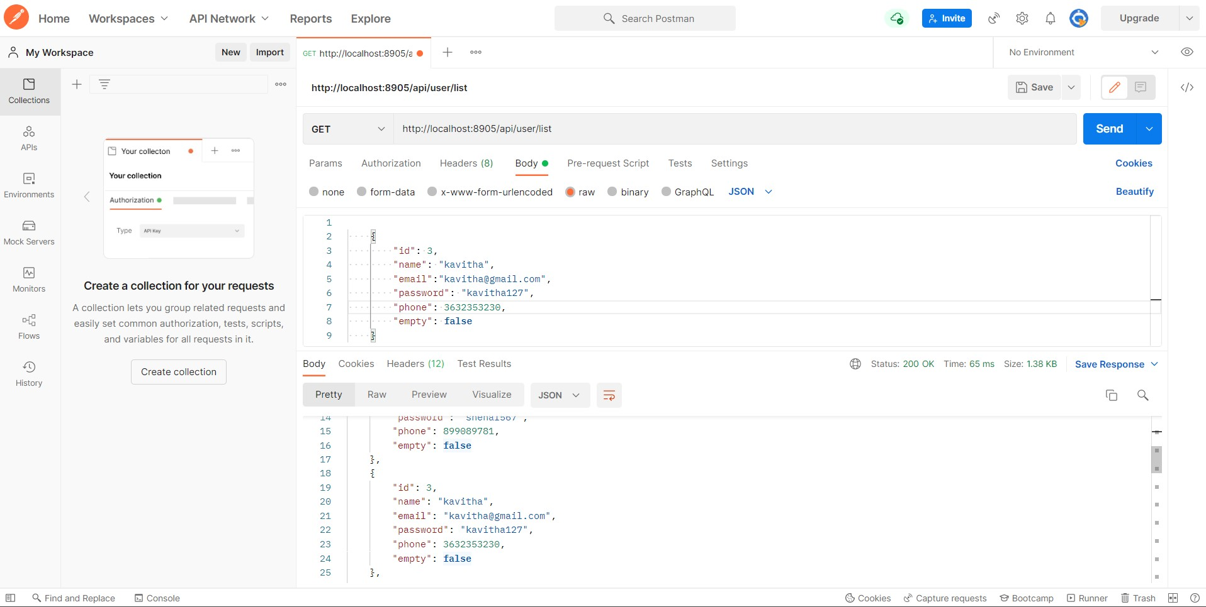

Slide 38
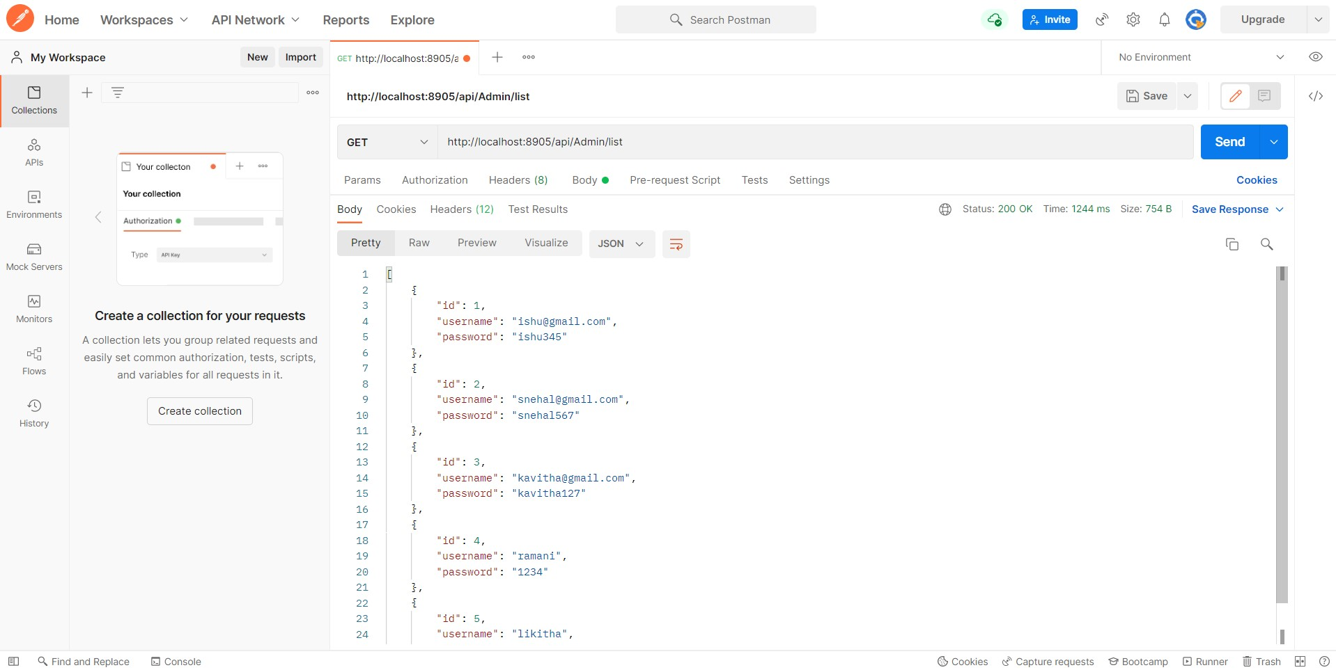

Slide 39
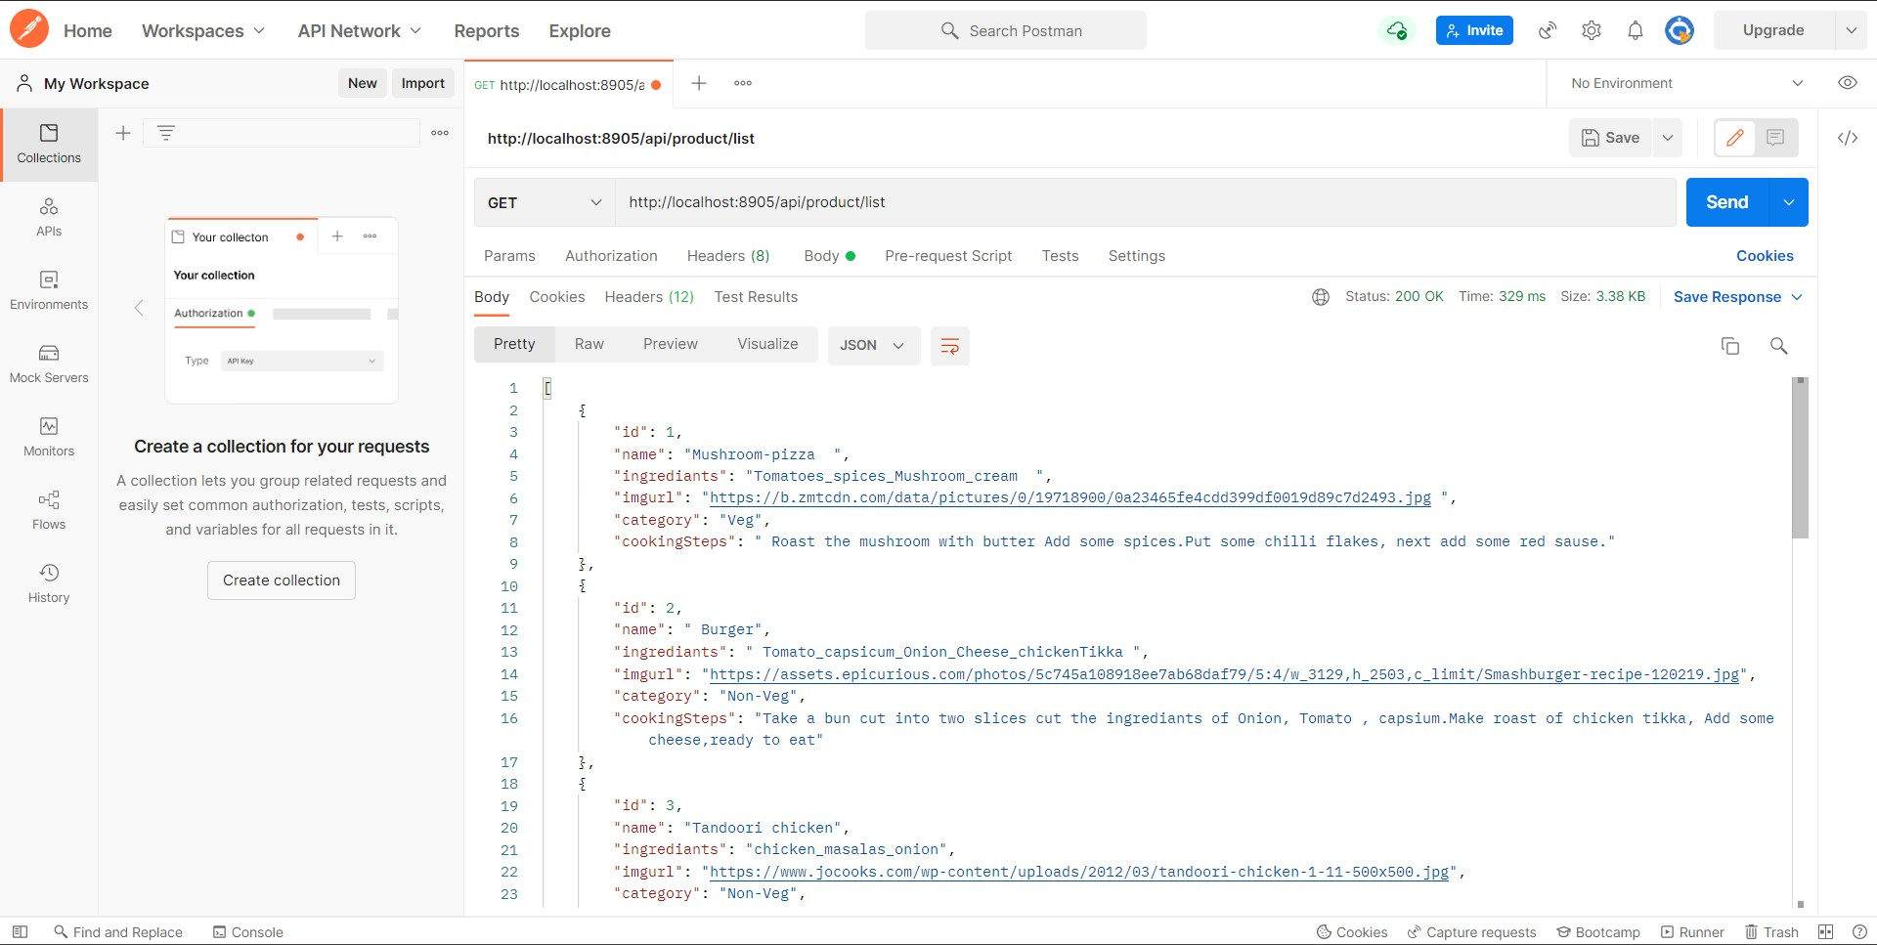

Slide 40
Advantages
Search for recipes based on the search keyword like item name, item description. User will be able to sort results based on different categories of the food items. It ensures the privacy of the users data and secures its access in the database and the maintenance of the application is also easy.

Slide 41
Future Work
* Add more user interface feature. * Promotional offer * Commercialize the web app

Slide 42
Conclusion
The main objective of the application is to understand the concept and implementation of Java, Spring Boot, Databases and Angular technology.
Our project helps the users to easily find out their choice of taste and recipe.

Slide 43


THANK YOU…..

